Slide 1
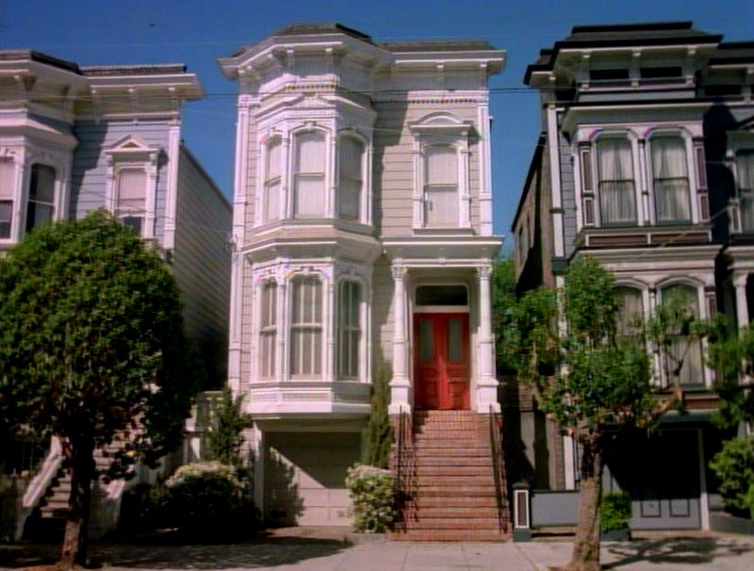
Real Estate Pricing
By: Kamarri Cummings

Slide 2
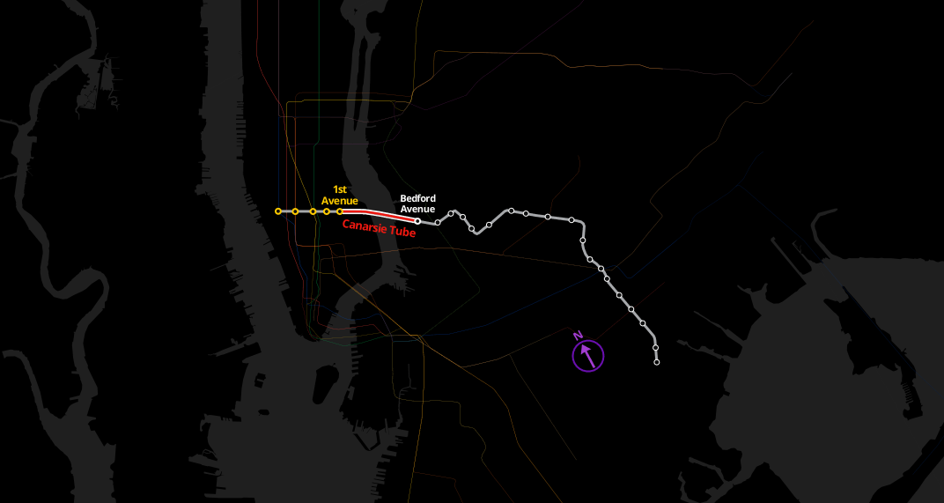
Original Idea: Predicting prices along the L train

Slide 3
History
Trend analysis
Construction spending
Residential Spending
Home Sales
State-level home spending reports
New home sales
Pending sales
NAHB’s Housing Market Index
Price Indices

Slide 4
Background:
The background of this project stems from the options and variables that potential homebuyers evaluate when deciding on purchasing a home.
The data is part of a competition that challenges you to predict the final price of each home.
The focus is on houses in Ames, Iowa.

Slide 5
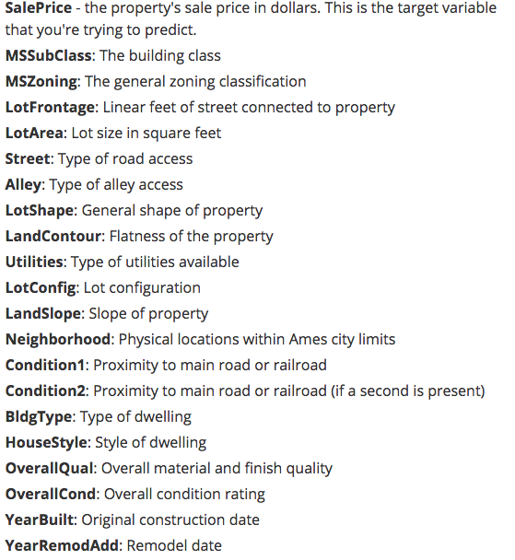
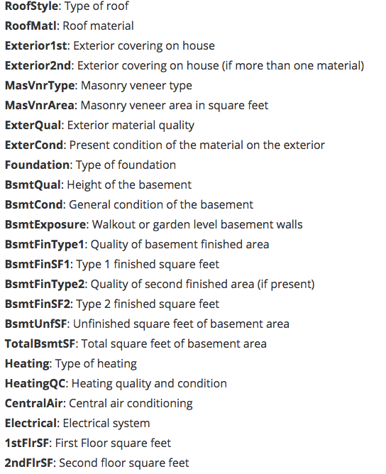
The Data
The Ames Housing dataset is provided from Dean De Cock for the use of data science education. It is an alternative for data scientists who are looking for a more modern and expanded version of the popular Boston Housing dataset.
This data set contains 79 explanatory variables (below are some of variables.

Slide 6
Problem:
For years, many people and organizations, from various industries, have attempted to predict the prices at which an individual or family will pay for a house. The ability to predict the price of a home value is not only beneficial on the individual level, but on a larger economic scale. There are several factors that may influence the price of one's home and value.

Slide 7
Hypothesis:
I believe that there is a direct relationship, and one of the most important factors to consider, between paying a higher price for property when the size of the property being sold is larger. I believe that the larger the Lot Frontage of the property, which is the linear feet of street connect to the property, the higher the selling price of that property.

Slide 8
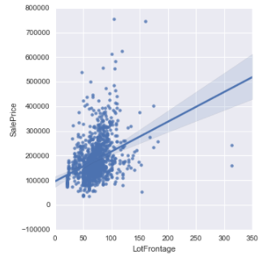
Exploring the data:
This visual demonstrates the relationship between Lot Frontage and sales price.

Slide 9
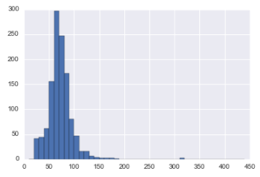
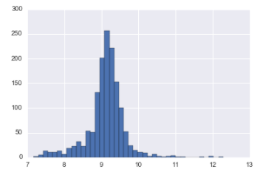
Comparing some variables
Lot Frontage
Lot Area

Slide 10
Goal:
Use the data to provide predictive modeling techniques to see which model will provide the best outcome to support my hypothesis.

Slide 11
Steps:
Some of the best options for predicting real estate prices would be Decision Trees, Linear Regressions and Random Forest

Slide 12
Best Model: Decision Tree: Returned an accuracy score of 48%

Slide 13
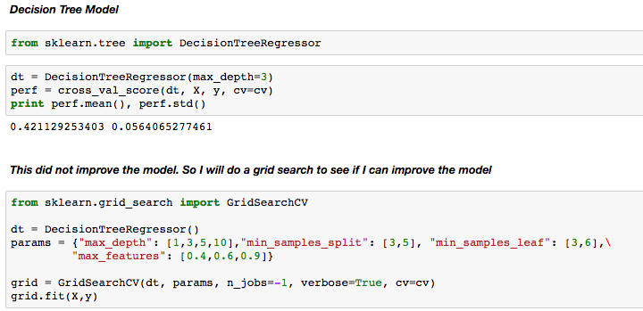

Decision Tree:
Simple English:
(non-technical jargon)
This was the best model that returned an accuracy score of 48%

Slide 14
Next Steps
-Try other variables
-support vector machine
-least squares support vector machine
-partial least squares
*rework and tune up this project and enter it into the competition to beat Jeremy
Research article that uses various machine learning methods that forecasts housing values.
https://www.hindawi.com/journals/aaa/2014/648047/

Slide 15
Thank you

